Slide 1
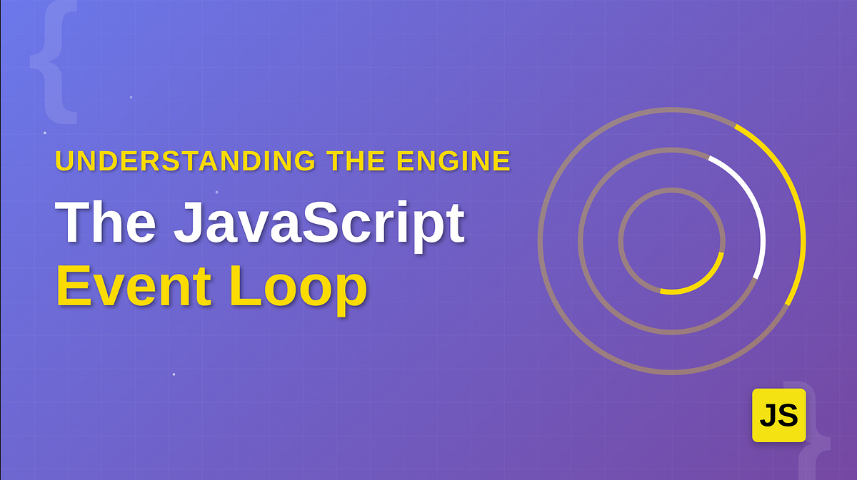
& JS Engine
Instructor: Abid Ali

Slide 2
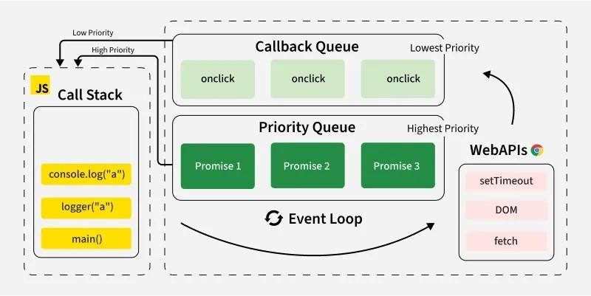
JS Engine Flow Diagram

Slide 3
Learning Objectives
By the end of this session, you will be able to:
• Understand how JavaScript executes code internally
• Explain the Call Stack
• Explain Web APIs / Node APIs
• Understand the Callback Queue
• Understand the Microtask Queue
• Explain how the Event Loop works
• Predict output of async code

Slide 4
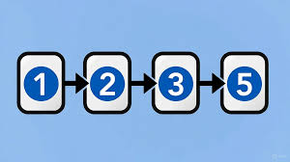
JavaScript is Single Threaded
JavaScript runs in a single thread:
• One task at a time
• One call stack
• One line of execution
Question:
If JS is single-threaded, how does it handle multiple tasks?
Answer:
It uses the runtime environment (Browser/Node).

Slide 5
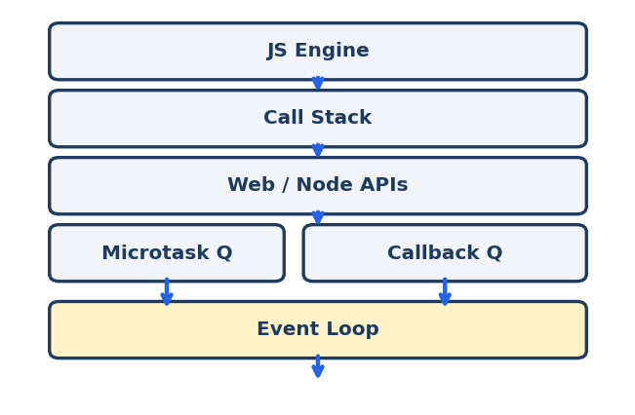
JavaScript Runtime
JavaScript runs inside a runtime environment.
JS Runtime Components:
• JS Engine (V8, SpiderMonkey)
• Call Stack
• Web APIs / Node APIs
• Callback Queue
• Microtask Queue
• Event Loop

Slide 6
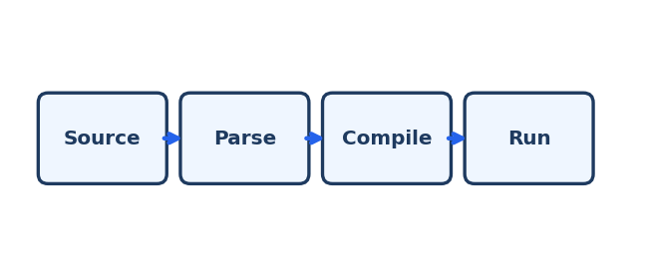
JS Engine (V8)
JS Engine Responsibilities:
• Parses code
• Converts to machine instructions
• Executes code line by line
Popular JS Engines:
• Chrome → V8
• Firefox → SpiderMonkey
• Safari → JavaScriptCore

Slide 7
The Call Stack
Call Stack = Execution Stack
• Keeps track of function calls
• Uses LIFO (Last In First Out)
Example:
function a() { console.log(‘A'); }
function b() { a(); console.log('B'); }
b();
Output:
A
B

Slide 8
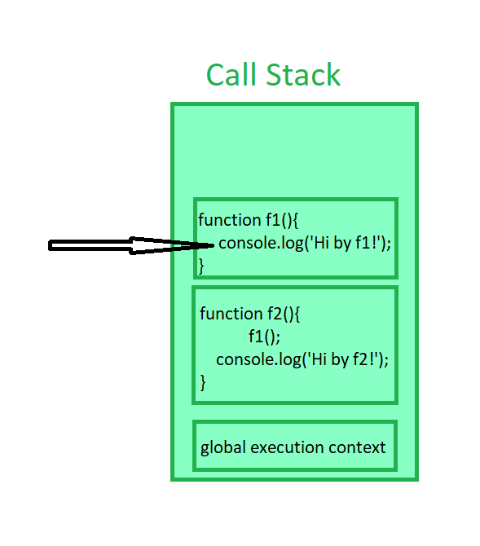
Call Stack Visualization
Example:
function first() { console.log('first'); }
function second() { first(); console.log('second'); }
second();
Stack Process:
1. second() pushed
2. first() pushed
3. first() executed and popped
4. second() continues
5. second() popped

Slide 9
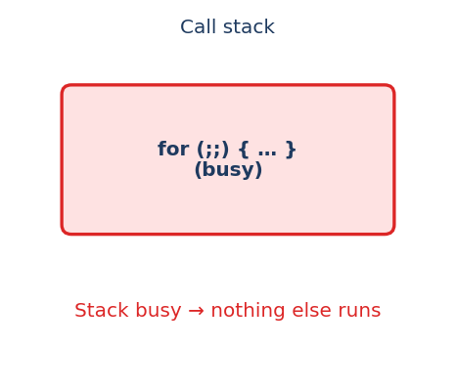
Blocking the Call Stack
If call stack is busy → JS becomes slow/freezes.
Example:
console.log('Start');
for (let i = 0; i < 1000000000; i++) {}
console.log('End');
Output:
Start
End
Explanation:
The loop blocks everything until finished.

Slide 10
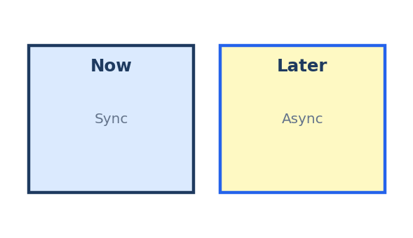
Synchronous vs Asynchronous
Synchronous Code:
• Runs line by line
• Blocks execution
Asynchronous Code:
• Runs later
• Uses runtime environment
Examples:
• setTimeout
• fetch
• DOM events
• file system (Node)

Slide 11
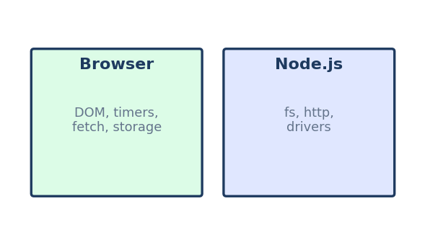
Web APIs / Node APIs
Web APIs (Browser provides):
• setTimeout
• fetch
• DOM events
• localStorage
Node APIs (Node provides):
• fs module
• http server
• database drivers
JavaScript delegates async tasks to these APIs.

Slide 12
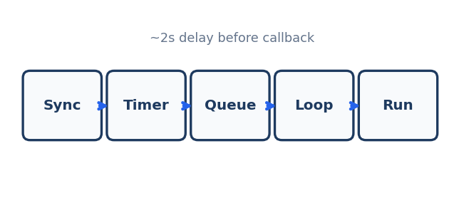
setTimeout Example
console.log('Start');
setTimeout(() => { console.log('Timeout done'); }, 2000);
console.log('End');
Output:
Start
End
Timeout done
Why?
setTimeout goes to Web API, callback waits, later enters the queue.

Slide 13
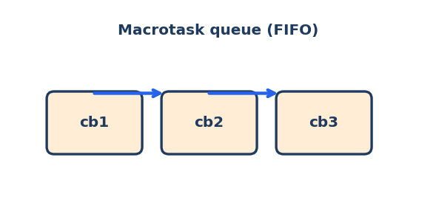
Callback Queue (Macrotask Queue)
Callback Queue stores callbacks waiting for execution.
Examples that go to Callback Queue:
• setTimeout
• setInterval
• click events
Important:
Callback queue executes only when call stack is empty.

Slide 14
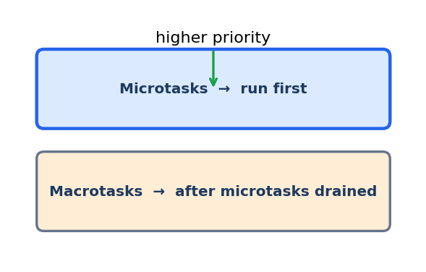
Microtask Queue
Microtask queue has higher priority than callback queue.
Examples:
• Promise.then()
• async/await continuation
• queueMicrotask()
Rule:
Microtasks always execute before callback queue tasks.

Slide 15
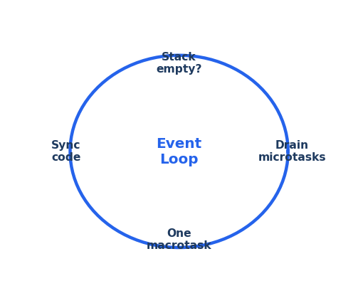
Event Loop
Event Loop = Manager of Execution
Job:
• Checks if call stack is empty
• Moves tasks from queues to call stack
Execution Order:
1. Execute synchronous code
2. Execute all microtasks
3. Execute one callback task
4. Repeat

Slide 17
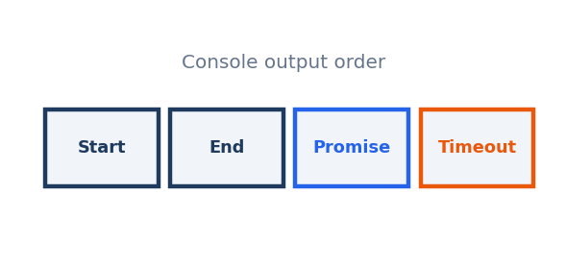
Microtask vs Callback Example
console.log('Start');
setTimeout(() => console.log('Timeout'), 0);
Promise.resolve().then(() => console.log('Promise'));
console.log('End');

Slide 18
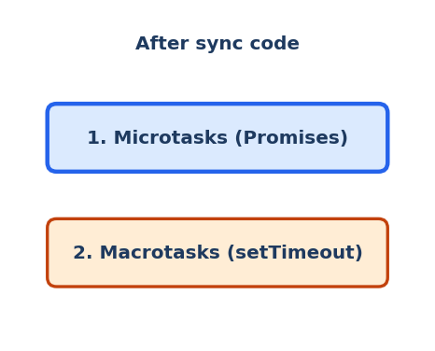
Why Promise Runs Before Timeout
Because:
• Promise.then() goes to Microtask Queue
• setTimeout goes to Callback Queue
• Event loop clears microtasks first
Priority:
Microtasks > Macrotasks

Slide 19
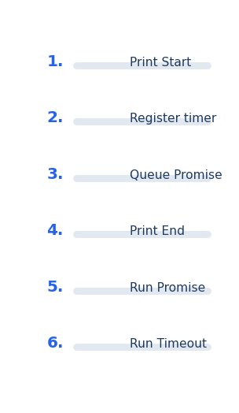
Event Loop Execution Steps
For the previous code:
1. Start printed (sync)
2. Timeout registered (Web API)
3. Promise registered (Microtask queue)
4. End printed (sync)
5. Call stack empty
6. Microtask runs (Promise)
7. Callback queue runs (Timeout)

Slide 20
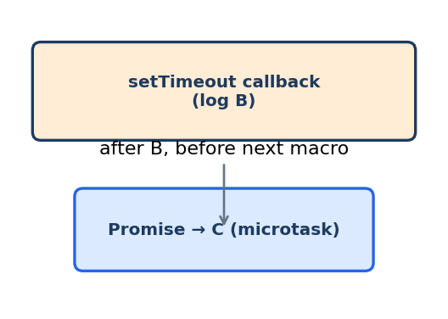
Nested Example
console.log('A');
setTimeout(() => {
console.log('B');
Promise.resolve().then(() => console.log('C'));
}, 0);
console.log('D');
Expected Output:
A
D
B
C

Slide 21
Common Interview Questions
What is the Event Loop?
• A mechanism that checks call stack and queues to execute async callbacks.
What is the Call Stack?
• A structure that keeps track of currently executing functions.

Slide 22
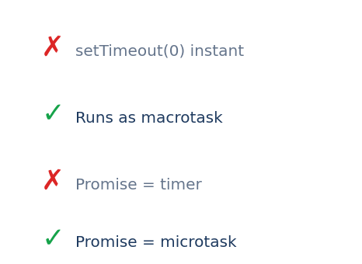
Common Mistakes
❌ setTimeout(fn, 0) runs immediately
✅ It runs after the call stack is empty
❌ Promise is async like timeout
✅ Promise microtask runs before timeout

Slide 23
Quick Practice Question
Predict the output:
console.log('1');
setTimeout(() => console.log('2'), 0);
Promise.resolve().then(() => console.log('3'));
console.log('4');
Correct Output:
1
4
3
2

Slide 24
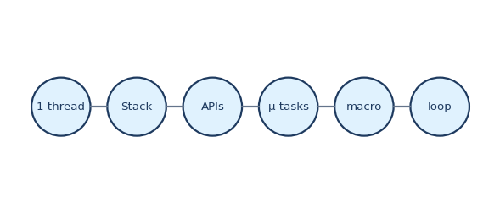
Summary
Key Takeaways:
• JS is single-threaded
• Call stack executes synchronous code
• Web APIs handle async tasks
• Microtask queue has highest priority
• Callback queue runs after microtasks
• Event loop manages execution order

Slide 25
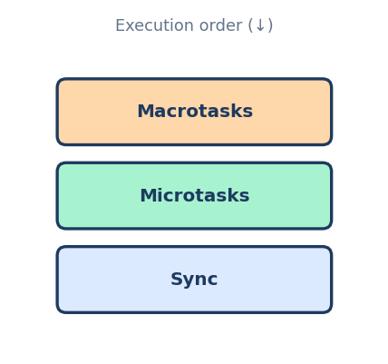
Final Golden Rule
Execution Priority:
1. Sync Code
2. Microtasks (Promises)
3. Macrotasks (Timeouts, Events)

Slide 26
Homework
Create eventloop.js with 3 examples and expected outputs.

Slide 27

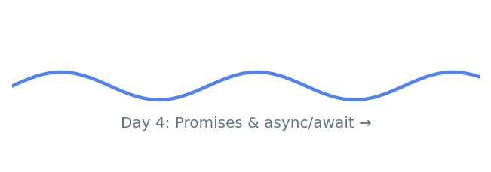
Thank You!

